Slide 1
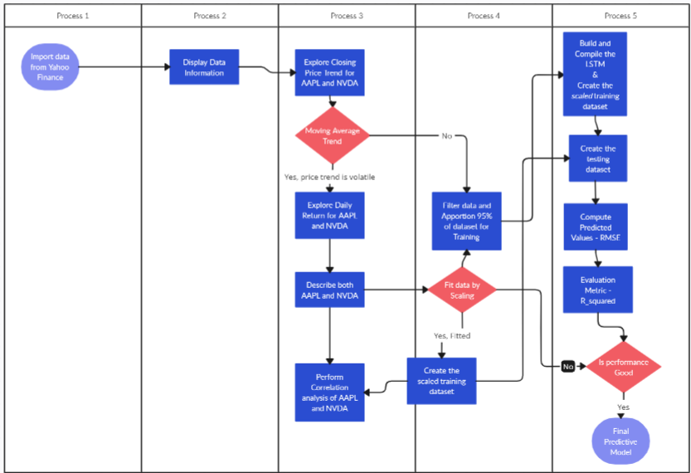
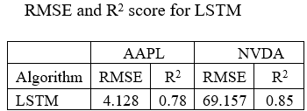
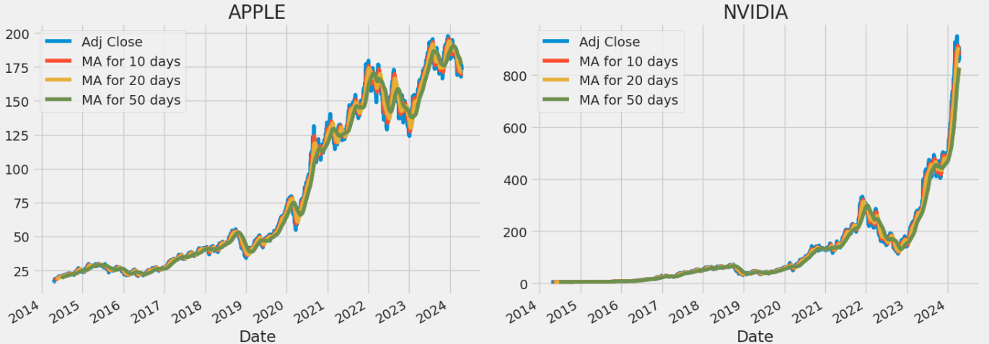
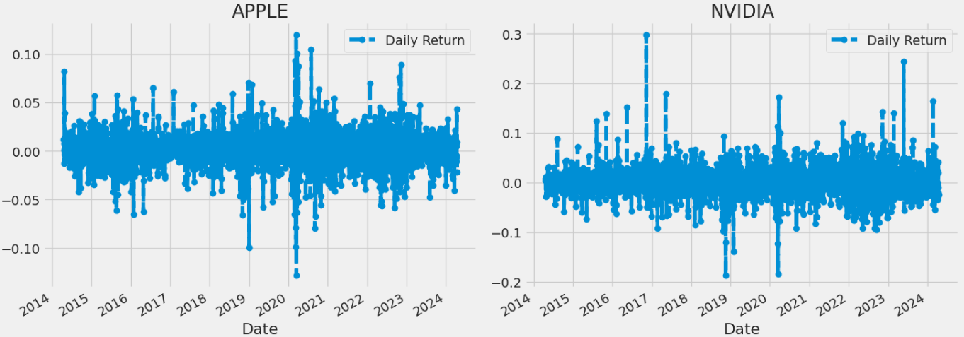
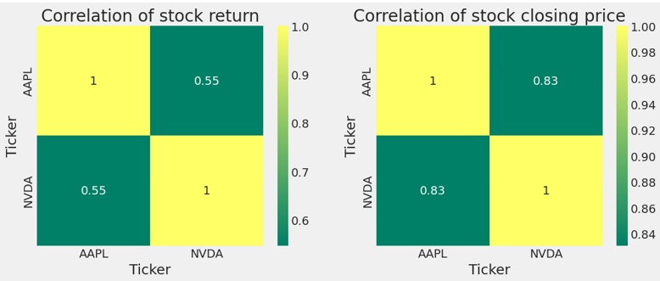
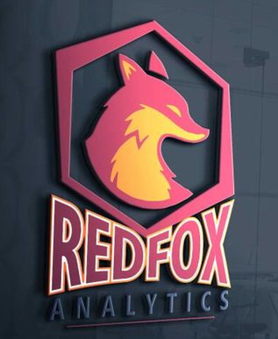
Stock trend analysis using the LSTM machine learning (ML) technique.
Background
Methods
Performance
Problem - The study was conducted to accurately monitor the performance of the model during the analytical process due to the intricate and non-linear nature of the stock market.
Gap - The majority of stock research strategies that rely on machine learning are constructed using data-driven models. The method of analysis lacks interpretability, and the outcomes are not traceable.
The project aim;
To evaluate the performance and predict the return of Apple and NVIDIA stocks
Specifically, the objectives of the study include;
To study and review LSTM and other relevant ML methods for the analysis of the stock market.
To source requisite daily stock data from financial market data hubs such as; Yahoo Finance spanning 10 years.
To collect and collate data on the top-2 technology stock of March 2024 week 1 namely; AAPL, and NVDA.
To build and compile the LSTM-ML model for stock market forecasting using historical stock market data.
To predict stock market returns (from price trends) using LSTM from selected input features (see Table 3a).
To compare the performance of the two stocks based on the valid and predicted values from the LSTM model.
To suggest future directions for ML stock market prediction research based on the results.
To present an efficient approach that can help investors and traders make better decisions for sustained growth or revenue.
LSTM Prediction
The LSTM predicts the target value (closing price) of Apple better than Nvidia. The R² shows how much dispersion or variation of the adjusted close price is explained by the open, high, low, and close price. In other words, the AAPL data fits the LSTM by approximately 78% when compared to 85% for NVDA.
Although NVDA yields better returns for traders and investors as indicated by the standard deviation, skewness, and kurtosis (see Table 5) as well as the prediction change (see Table 8 below), it does not guarantee long-term stability, as suggested by the LSTM-RMSE results.
The predictions are derived from the test data (5%), and NVIDIA (figure 6b) performs better than Apple (figure 6a) for a risk-loving investor who is focused on return.
This research will employ a software methodology to utilize various machine learning techniques to forecast the trajectory of the stock market for Apple Inc., and NVIDIA Corporation stocks. The Google Colab implementation of this prediction system uses Python frameworks such as Scikit-learn, Pandas, NumPy, and Plotly.
This study utilized a total of two unique stocks. The historical stock values for each stock, span a period of 10 years and were obtained by downloading them from Yahoo Finance. The stocks are the biggest movers of the market as of March 6, 2024 (Yahoo Finance, 2024).
Exploratory Data Analysis - EDA
Conclusion
In this study, the LSTM algorithm is trained and tested on the Apple and NVIDIA datasets from 2014 to 2024. The results are then carefully assessed and recorded to determine the level of performance, in terms of accuracy and efficiency of stock price prediction. The evaluation criteria used were RMSE and R² score.
The testing results are essential in determining the effectiveness of the LSTM in stock price prediction.
The LSTM architecture is dynamic and adapts to changes in its variables. Based on the findings, it is evident that the LSTM model is efficient
Courtesy of the Data Analytics & Data Intelligence Team
Redfox Analytica

